Slide 1

Introduction to Eve
a multipurpose, web based agent platform
Almende B.V.
2012-06-08
http://almende.github.com/eve
http://www.almende.com

Slide 2
Agent platforms
AgentScape http://www.agentscape.org
Goal http://mmi.tudelft.nl/trac/goal
Jade http://jade.tilab.com
Janus http://www.janus-project.org
Jason http://jason.sourceforge.net
MadKit http://www.madkit.org
Our own platforms CAL and Emerge
Eve http://almende.github.com/eve

Slide 3
Overview
Concept
Modules
Demo
Hello World
Open ends

Slide 4
Design considerations
Keep it simple
Scalable, decentral, web based
Use existing infrastructure and protocols
Create an open platform, that works across system boundaries
Do not enforce a single programming language or deployment environment
Mimic human society and interaction
Inspired by RESTful JSON API's

Slide 5
Concept
The “Eve World” consists of the World Wide Web
Each Agent has its own unique URL
Agents communicate using JSON-RPC over HTTP POST requests

Slide 6
Protocol: JSON-RPC
Url | HTTP POST http://myserver.com/agents/type/id
Request | { "id": 1, "method": "add", "params": { "a": 2.2, "b": 4.5 } }
Response | { "id": 1, "result": 6.7, "error": null }

Slide 7
Resources
Common resources need to be standardized
Calendar Event
Geo location
Address
Activity
...

Slide 8
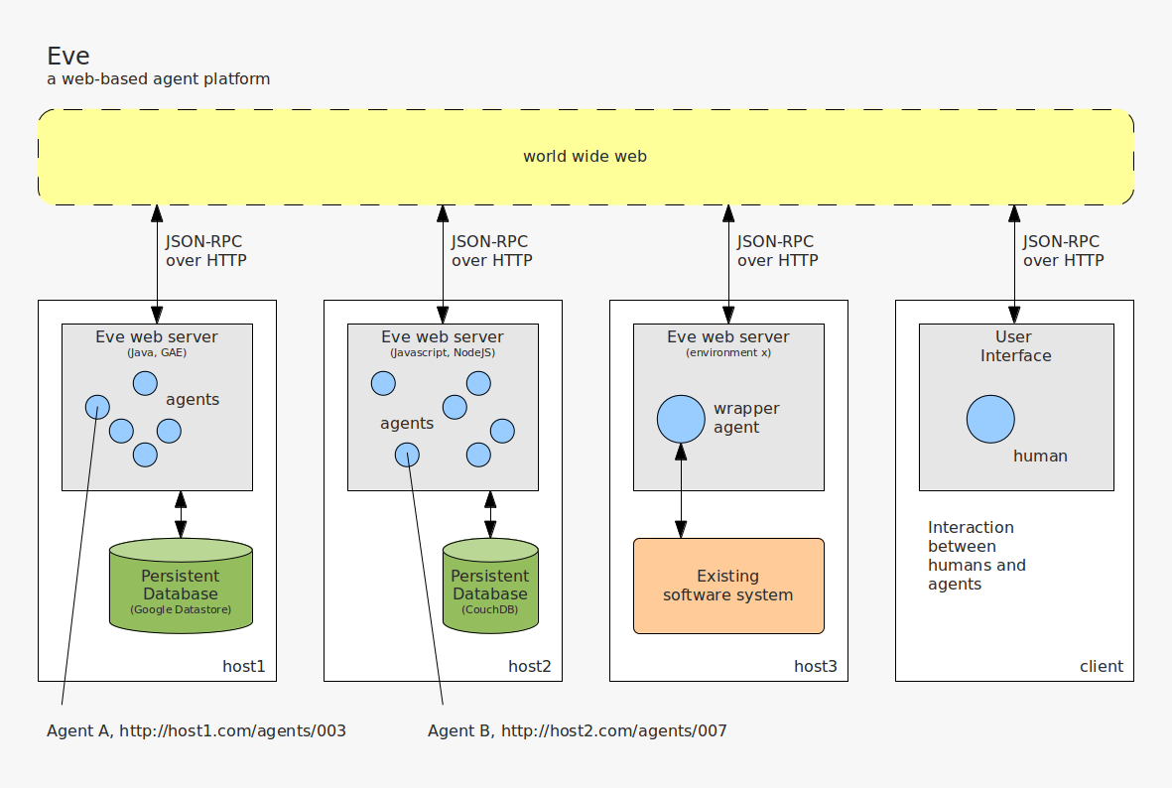
Concept

Slide 9
Implementations
The protocol is so simple – you don't need a library and can write your own interface in no time
Java implementation
Node.js implementation
More to come...

Slide 10
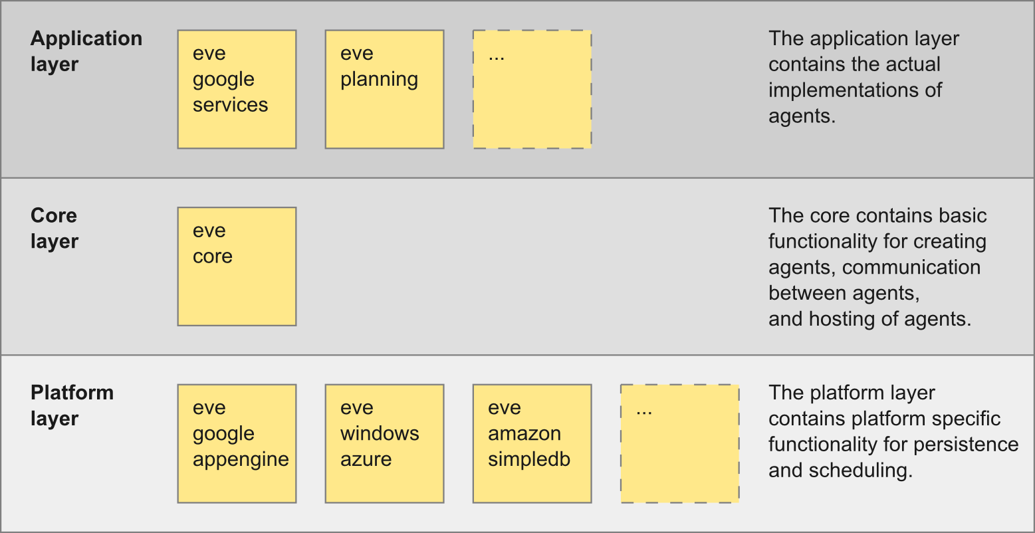
Java modules

Slide 11
Eve Core
Servlets: host a single or multiple agents
Resources: activity, geolocation, etc.
Agents:
  Stateless
  Context
  Event driven
  Subscribe to events
  Scheduler

Slide 12
Eve Planning
First implementation with real agents
Acts on the calendaring/planning domain
Implements:
  CalendarAgents for accessing various calendaring systems
  MeetingAgents for dynamically planning meetings
  DirectionsAgents for calculating travel time
Is being implemented in Ask's Paige

Slide 13
MeetingAgent Activity
Description
Constraints
  People/resources
  Location
  Time
Status
  Current status: planned, executing, canceled
  Planned status: resources, location, time

Slide 14
Example scenario
Gmail
Server
Calendar
Agent
Marty
Meeting
Agent
Directions
Agent
Google
Directions
API
Exchange
Server
Calendar
Agent
Alex
Meeting
Agent
...
Meeting
Agent

Slide 15
Demo time
Peer-to-peer chat agents
http://eveagents.appspot.com/agents/chatagent/1/
http://eveagents.appspot.com/agents/chatagent/2/
http://eveagents.appspot.com/agents/chatagent/3/
CalendarAgent and MeetingAgent
http://eveagents.appspot.com/demo/

Slide 16
Getting Started
Create a Java (web) project
Download the Eve libraries, add them to the build path of your project
Add an Eve config file, configure a servlet
Create your own agents

Slide 17
HelloWorldAgent (1/2)
public class HelloWorldAgent extends Agent {
public String welcome(@Name("name") String name) {
return "Hello " + name + "!";
}
@Override
public String getVersion() {
return "0.1";
}
@Override
public String getDescription() {
return "This agent can do this and that for you.";
}
}

Slide 18
HelloWorldAgent (2/2)
public class HelloWorldAgent extends Agent {
// ...
public void setUsername(@Name("username") String username) {
getContext().put("username", username);
}
public String getUsename() {
return getContext().get("username", String.class);
}
public void getOthersUsername() {
String url = "http://server/agents/helloworldagent/othersid";
String method = "getUsername";
ObjectNode params = null;
String username = send(url, method, params, String.class);
System.out.println("Others username is " + username);
}
}

Slide 19
Check it out
http://almende.github.com/eve/
Libraries
Documentation
Getting started
Examples

Slide 20
Current open ends
How to find agents? Centralistic directory services vs. mimicing the way humans learn to know each other
Authorization: traditional models vs. trust/reputation models
Handling (binary) resources: make a hybrid solution with RESTful API?
Algorithms for dynamically planning activities
Algorithms for negotiation between agents

Slide 21
What makes Eve unique?
Simple
Open environment
Scalable, decentral
Utilizes modern web & cloud solutions
Defines the protocol, does not dictate how to built or deploy your application

Slide 22
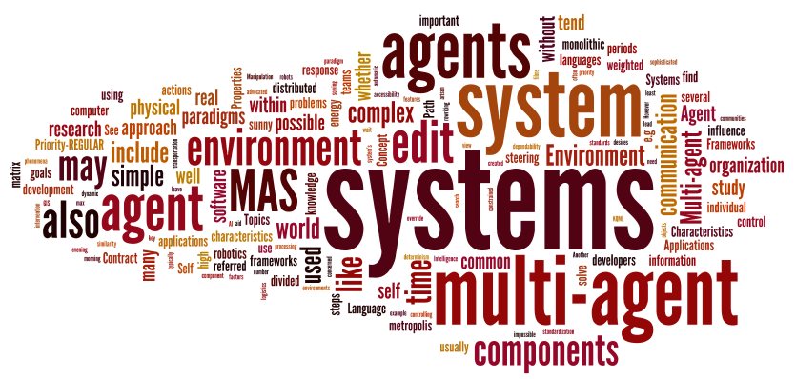
Discussion time
beer please...

